Slide 1

OCTOBER 23, 2021
AMAZON
FINE
FOOD REVIEWS
by:
Mohammed Sareh Assiri
SADIA-Bootcamp

Slide 2
OUTLINE
1-Dataset
2-Objctive
3-Baseline
4-Sentiment Analysis
5-Machine learning Approach
6-Results
7-Conclusion

Slide 3
ABOUT DATASET
THE DATA SET CONSISTS OF REVIEWS OF FINE FOODS FROM AMAZON OVER A PERIOD OF MORE THAN 10 YEARS, INCLUDING 568,454 REVIEWS TILL OCTOBER 2012. REVIEWS INCLUDE RATING, PRODUCT AND USER INFORMATION, AND A PLAIN TEXT REVIEW. IT ALSO INCLUDES REVIEWS FROM ALL OTHER AMAZON CATEGORIES.
We have the following columns:
Product Id: Unique identifier for the product
User Id: unique identifier for the user
Profile Name: Profile name of the user
Helpfulness Numerator: Number of users who found the review helpful
Helpfulness Denominator: Number of users who indicated whether they found the review helpful or not
Score: Rating between 1 and 5
Time: Timestamp
Summary: Summary of the review
Text: Review

Slide 4

OBJECTIVE
Given a review, determine whether the review is positive (rating of 4 or 5)or negative
(rating of 1 or 2).

Slide 5

GOAL
HOW TO DETERMINE IF A REVIEW IS POSITIVE OR NEGATIVE?
We could use Score/Rating. A rating of 4 or 5 can be considered as a positive review. A rating of 1 or 2 can be considered as a negative one. A review of rating 3 is considered neutral and such reviews are ignored from our analysis. This is an approximate and proxy way of determining the polarity (positivity/negativity) of a review.

Slide 6
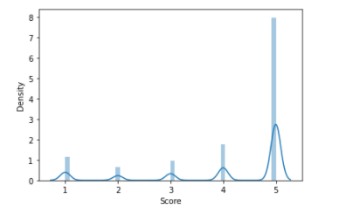
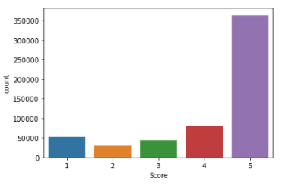
SCORE OF RATING
NOTE HERE:
Rating between 1 and 5

Slide 7

SENTIMENT ANALYSIS
this text number is (350):
These chocolate covered espresso beans are wonderful! The chocolate is very dark and rich and the "bean" inside is a very delightful blend of flavors with just enough caffine to really give it a zing.
In [11]:
POLARITY+ SUBJECTIVITY
WE NOTE :
POLARITY IS VERLY POSTIVE

Slide 8
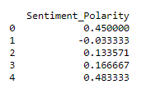



SENTIMENTANALYSIS
HEAD OF SENTMENT POLARITY:

Slide 9
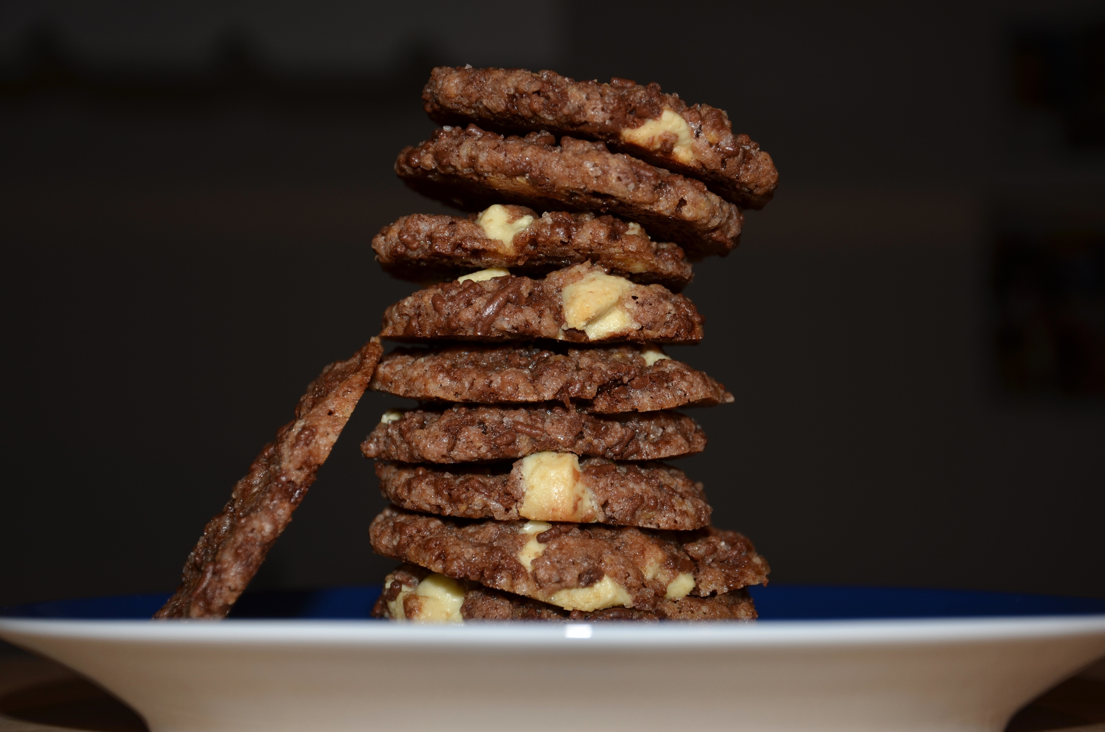
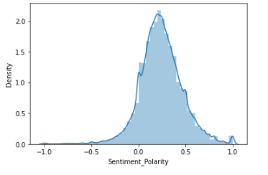
DISTRIBUTION PLOT
ABOUT:
SENTIMENT POLARITY

Slide 10
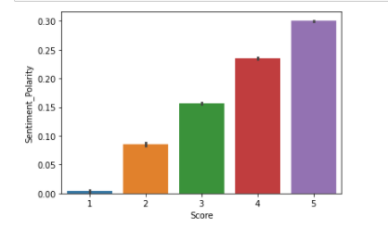
SENTIMENT ANALYSIS
WE NOTE HERE:
X=score
Y=sentiment polarity

Slide 11
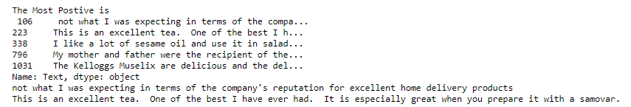
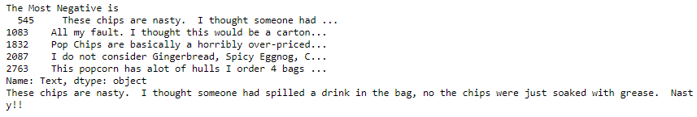
100%
MOST POSTIVE
100%
MOST NEGTIVE

Slide 12
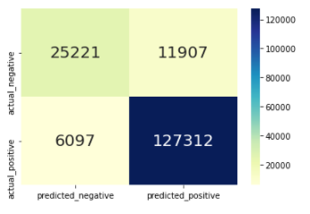
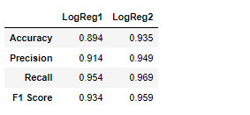
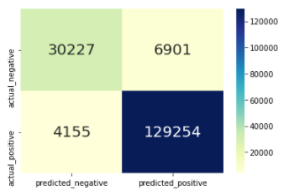

LOGISTIC REGRESSION
CONFUSION_MATRIX

Slide 13

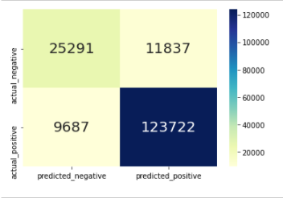
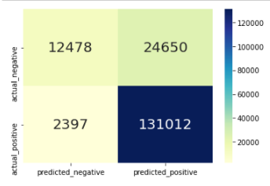
NAIVE BAYES
MULTINOMIALNB
BERNOULLINB

Slide 14
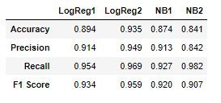
RESULTS
ALL OF THE ERROR METRICS INTO A DATA FRAME FOR COMPARISON

Slide 15
CONCLUSION
I have used the sentiment analysis and
I accomplished good results using the LogisticRegression model

Slide 16

THANK YOU!

